Slide 1

Multi-Layer Perceptron Based Health
Risk Prediction for Lung and Other Diseases
Guided By:
Mr. Suresh Kumar Srichandan
Presented By:
Gobinda Panda (2102040002)
Sugyani Manjari Dash (2102081031)
DEPARTMENT OF COMPUTER SCIENCE AND ENGINEERING,
VEER SURENDRA SAI UNIVERSITY OF TECHNOLOGY,
BURLA, SAMBALPUR – 7682018
[2024-2025]

Slide 2
Outline
Introduction
Literature Review
Methodology
Implementation
Result
Conclusion
Future Scope
References

Slide 3

Introduction
The rising burden of lung cancer, heart disease, and mental disorders is worsened by pollution, smoking, and stress.
Early diagnosis is critical, yet traditional methods are slow, costly, and invasive.
This study uses ML and deep learning on structured health data like smoking, anxiety, and fatigue for faster, non-invasive predictions.
Models applied include Random Forest, MLP, and LSTM, enhanced by feature engineering to improve accuracy and interpretability.

Slide 4
Literature Review
Sl. No. | Author(s) | Year | Outcome
1 | Sharma & Goyal | 2020 | Demonstrated SVM & Random Forest effectiveness in early lung cancer detection
2 | Rahman & Muniyandi | 2014 | Compared data mining techniques for lung cancer prediction from structured records
3 | Choudhury & Gupta | 2022 | Reviewed ML-based lung cancer detection, highlighting feature engineering improvements
4 | Mohan et al. | 2019 | Achieved high heart disease prediction accuracy using hybrid ML techniques
5 | Dwivedi | 2018 | Found ensemble methods (RF, XGBoost) effective for heart disease prediction
6 | Chen & Guestrin | 2016 | Developed XGBoost as scalable, high-performance algorithm for classification tasks
7 | Haraty & Zantout | 2020 | Applied ML algorithms to predict mental health issues

Slide 5
Methodology
Data Preparation Overview
1. Synthetic Data : Added some new rows to the dataset
2. Preprocessing Steps : Label encoding (e.g., gender, disease status)
Binary feature standardization (0 = No, 1 = Yes)
Initial Dataset:
GENDER | AGE | SMOKING | YELLOW_FINGERS | ANXIETY | PEER_PRESSURE | CHRONIC DISEASE | FATIGUE | ALLERGY | WHEEZING | ALCOHOL CONSUMING | COUGHING | SHORTNESS OF BREATH | SWALLOWING DIFFICULTY | CHEST PAIN | LUNG_CANCER
M | 69 | 1 | 2 | 2 | 1 | 1 | 2 | 1 | 2 | 2 | 2 | 2 | 2 | 2 | YES
M | 74 | 2 | 1 | 1 | 1 | 2 | 2 | 2 | 1 | 1 | 1 | 2 | 2 | 2 | YES
F | 59 | 1 | 1 | 1 | 2 | 1 | 2 | 1 | 2 | 1 | 2 | 2 | 1 | 2 | NO

Slide 6
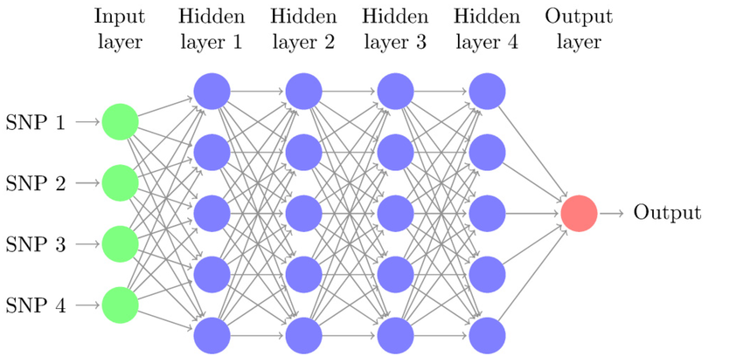
Multilayer Perceptron Working
Structure: Input layer receives data; multiple hidden layers process it.
Neurons: Nodes connect fully between layers, passing weighted signals.
Activation Function: ReLU (Rectified Linear Unit) activation avoids training issues and speeds learning.
Learning: Backpropagation adjusts weights, minimizing prediction errors.
Optimization: Adam optimizer enhances accuracy during training.

Slide 7
Algorithm
Data Preparation:
Isolate features (X) by removing the 'LUNG_CANCER' column.
Define the target (y) as the 'LUNG_CANCER' column.
Preprocess Features & Target:
Convert text-based categories in features (X) to numeric labels.
If the target (y) contains text labels, convert them to numeric values.
Split Data: Divide the dataset into 80% training and 20% testing subsets.
Normalize Features: Scale training and testing data to ensure features have consistent ranges.
Build MLP Model: Create a neural network with:
100 neurons in the first hidden layer, 50 in the second.
ReLU activation for nonlinearity.
Adam optimizer for weight adjustments.
Early stopping to halt training if no improvement (10% validation subset).

Slide 8
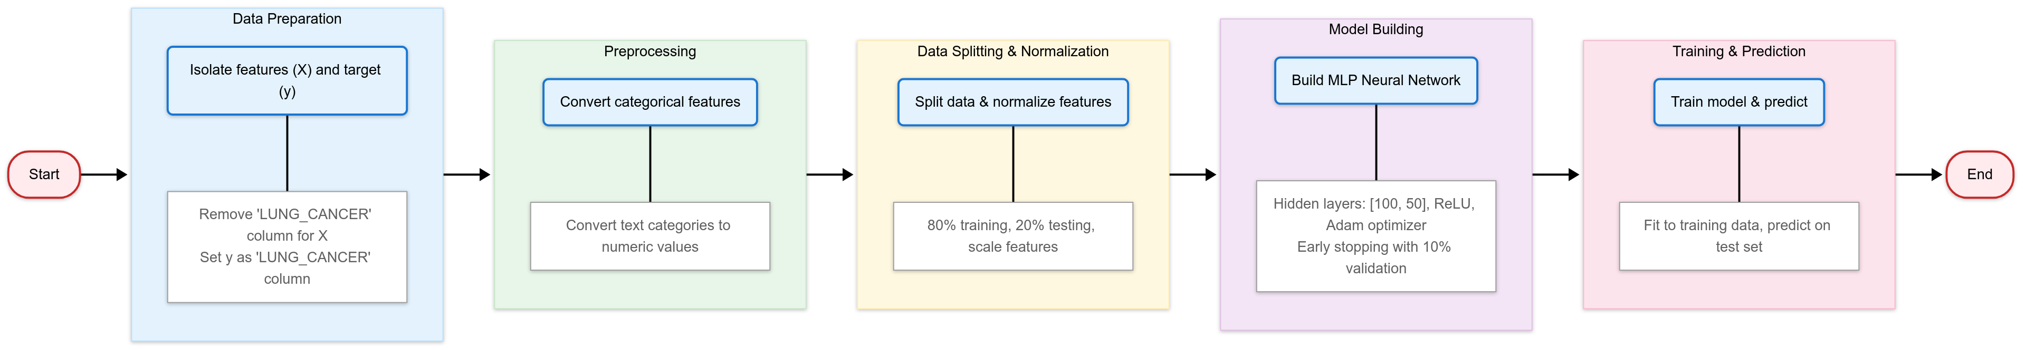
Flowchart
6. Train & Predict:
Fit the model to the training data.
Use the trained model to predict outcomes for the test set.

Slide 9
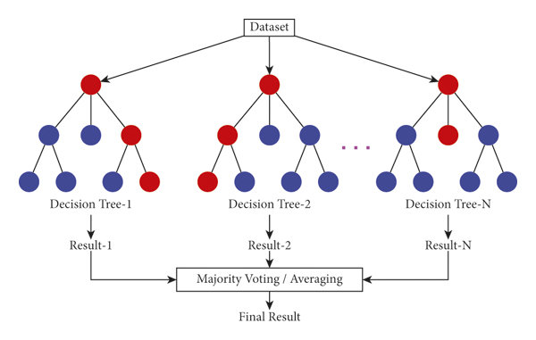
Random Forest Working
Ensemble Learning: Combines multiple decision trees to improve accuracy.
Randomness: Uses random data subsets and feature splits to reduce overfitting.
Voting Mechanism: Trees vote for classification or average regression results.
Versatility: Handles high-dimensional, numeric, and categorical data effectively.
Feature Importance: Identifies key predictors without extensive preprocessing.

Slide 10
Implementation
 | Predicted Negative (0) | Predicted Positive (1)
Actual Negative (0) | True Negative (TN): Correct negative predictions | False Positive (FP): Incorrect positive predictions
Actual Positive (1) | False Negative (FN): Missed positive cases | True Positive (TP): Correct positive predictions
Metric | Formula
Accuracy | (TP + TN) / (TP + TN + FP + FN)
Precision | TP / (TP + FP)
Recall (Sensitivity) | TP / (TP + FN)
F1 Score | 2 * (Precision * Recall) / (Precision + Recall)

Slide 11
Lung Cancer Prediction
Random Forest Classifier: F1-score 0.88, Accuracy 0.80 for lung cancer prediction
Baseline MLP: Improved with F1-score 0.90 and Accuracy 0.83
Feature Engineering: Adding 5 new features (Risk Score, Smoke Alcohol, Age Group, Physical Symptoms Count, Mental Health Score) increased MLP performance to F1-score 0.91 and Accuracy 0.84
Refined Features: Removing redundancy (Age, Smoking, Alcohol Consuming) achieved best results: F1-score 0.94, Accuracy 0.89
GENDER | SMOKING | YELLOW_FINGERS | ANXIETY | PEER_PRESSURE | CHRONIC DISEASE | FATIGUE | ALLERGY | WHEEZING | ALCOHOL CONSUMING | COUGHING | SHORTNESS OF BREATH | SWALLOWING DIFFICULTY | CHEST PAIN | LUNG_CANCER | RISK_SCORE | SMOKE_ALCOHOL | AGE_GROUP | PHYSICAL_SYMPTOMS_COUNT | MENTAL_HEALTH_SCORE
1 | 0 | 1 | 1 | 0 | 0 | 1 | 0 | 1 | 1 | 1 | 1 | 1 | 1 | 1 | 4 | 0 | 2 | 4 | 1
1 | 1 | 0 | 0 | 0 | 1 | 1 | 1 | 0 | 0 | 0 | 1 | 1 | 1 | 1 | 2 | 0 | 2 | 3 | 0
0 | 0 | 0 | 0 | 1 | 0 | 1 | 0 | 1 | 0 | 1 | 1 | 0 | 1 | 0 | 2 | 0 | 1 | 3 | 1

Slide 12
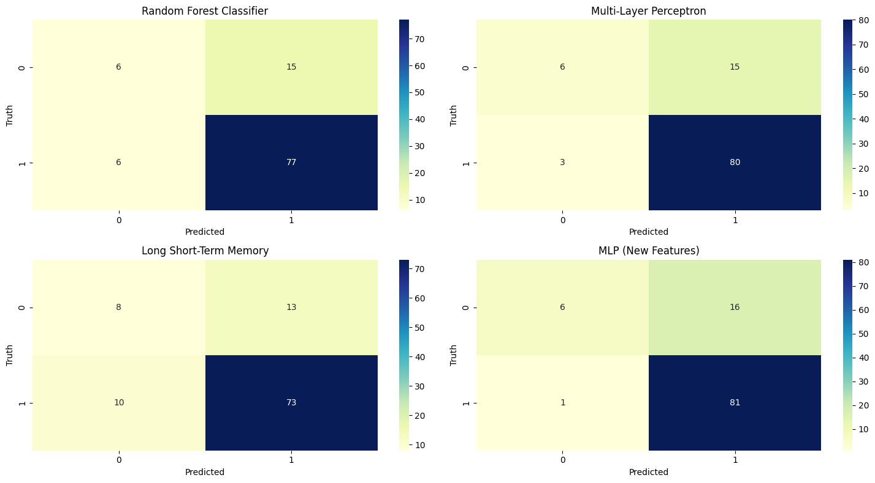
Lung Cancer Confusion Matrix

Slide 13
Mental Health Prediction
Derived Score: Mental Health Score engineered by combining anxiety and peer pressure
Feature Reduction: Removed anxiety and peer pressure columns to simplify data.
Random Forest: Achieved strong results with F1-score 0.81 and accuracy 0.78.
LSTM Limitations: Lower performance (F1 score 0.66, accuracy 0.64) on mental health task.
GENDER | SMOKING | YELLOW_FINGERS | CHRONIC DISEASE | FATIGUE | ALLERGY | WHEEZING | ALCOHOL CONSUMING | COUGHING | SHORTNESS OF BREATH | SWALLOWING DIFFICULTY | CHEST PAIN | LUNG_CANCER | RISK_SCORE | SMOKE_ALCOHOL | AGE_GROUP | PHYSICAL_SYMPTOMS_COUNT | MENTAL_HEALTH_SCORE
1 | 0 | 1 | 0 | 1 | 0 | 1 | 1 | 1 | 1 | 1 | 1 | 1 | 4 | 0 | 2 | 4 | 1
1 | 1 | 0 | 1 | 1 | 1 | 0 | 0 | 0 | 1 | 1 | 1 | 1 | 2 | 0 | 2 | 3 | 0
0 | 0 | 0 | 0 | 1 | 0 | 1 | 0 | 1 | 1 | 0 | 1 | 0 | 2 | 0 | 1 | 3 | 1

Slide 14
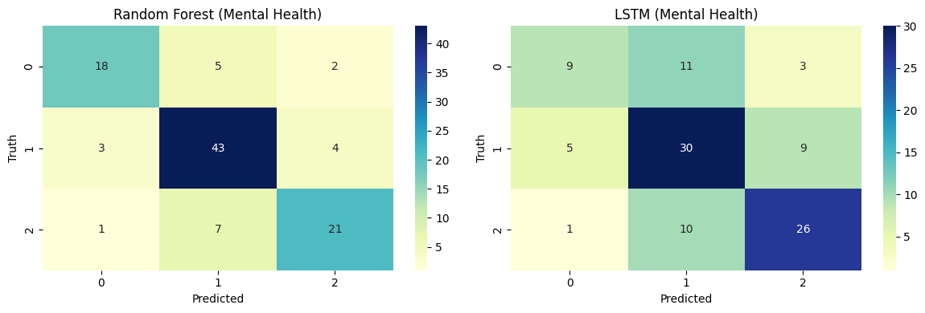
Mental Health Confusion Matrix

Slide 15
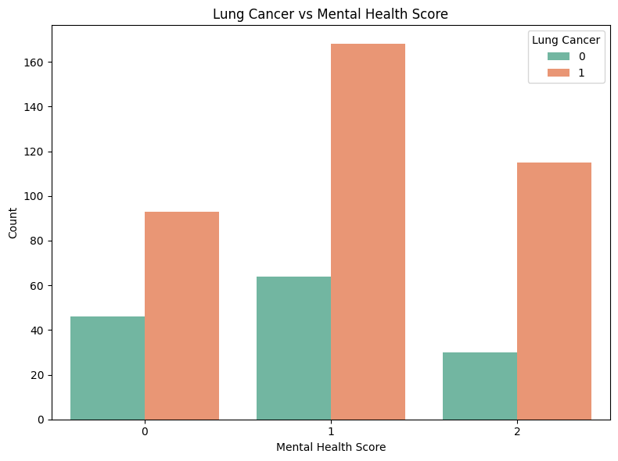
Lung Cancer vs Mental Health

Slide 16
Jaundice Prediction
Synthetic Feature Creation: Combined alcohol use, chronic disease, and yellow fingers indicators.
Feature Reduction: Excluded original features to prevent redundancy and overfitting.
Random Forest Performance: Achieved F1-score 0.85 and accuracy 0.82, showing strong classification.
MLP Model Results: Moderate F1-score 0.78 and accuracy 0.69, reflecting challenges with fewer features.
GENDER | AGE | SMOKING | ANXIETY | PEER_PRESSURE | FATIGUE | ALLERGY | WHEEZING | COUGHING | SHORTNESS OF BREATH | SWALLOWING DIFFICULTY | CHEST PAIN | LUNG_CANCER | JAUNDICE
1 | 69 | 0 | 1 | 0 | 1 | 0 | 1 | 1 | 1 | 1 | 1 | 1 | 1
1 | 74 | 1 | 0 | 0 | 1 | 1 | 0 | 0 | 1 | 1 | 1 | 1 | 0
0 | 59 | 0 | 0 | 1 | 1 | 0 | 1 | 1 | 1 | 0 | 1 | 0 | 0

Slide 17
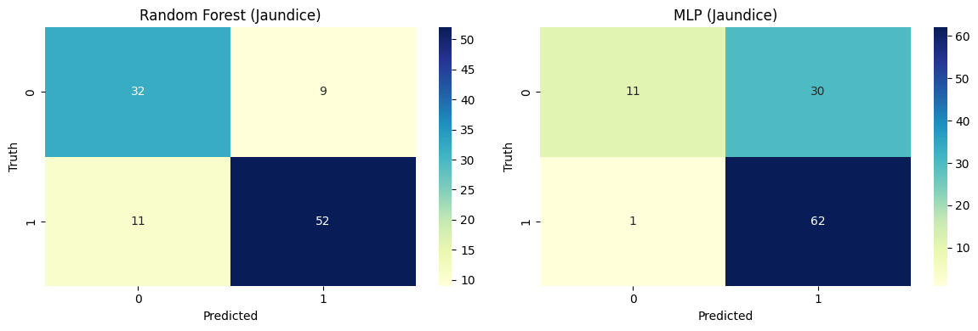
Jaundice Confusion Matrix

Slide 18
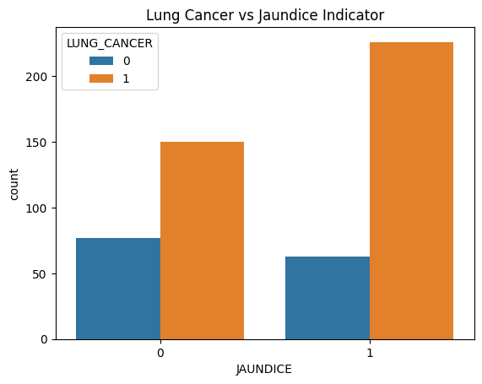
Lung Cancer vs Jaundice

Slide 19
Heart Problem Prediction
Feature synthesis: Combined 11 health indicators into a single Heart Problem label.
Key indicators: Included smoking, anxiety, chronic disease, fatigue, and more.
Performance: Both Random Forest and MLP models scored F1-score 0.95, accuracy 0.93.
Effectiveness: Derived features enhanced model robustness and prediction accuracy.
GENDER | SMOKING | YELLOW_FINGERS | ANXIETY | PEER_PRESSURE | CHRONIC DISEASE | FATIGUE | ALLERGY | WHEEZING | ALCOHOL CONSUMING | COUGHING | SHORTNESS OF BREATH | SWALLOWING DIFFICULTY | CHEST PAIN | LUNG_CANCER | RISK_SCORE | SMOKE_ALCOHOL | AGE_GROUP | PHYSICAL_SYMPTOMS_COUNT | MENTAL_HEALTH_SCORE | HEART_PROBLEM
1 | 0 | 1 | 1 | 0 | 0 | 1 | 0 | 1 | 1 | 1 | 1 | 1 | 1 | 1 | 4 | 0 | 2 | 4 | 1 | 1
1 | 1 | 0 | 0 | 0 | 1 | 1 | 1 | 0 | 0 | 0 | 1 | 1 | 1 | 1 | 2 | 0 | 2 | 3 | 0 | 1
0 | 0 | 0 | 0 | 1 | 0 | 1 | 0 | 1 | 0 | 1 | 1 | 0 | 1 | 0 | 2 | 0 | 1 | 3 | 1 | 1

Slide 20
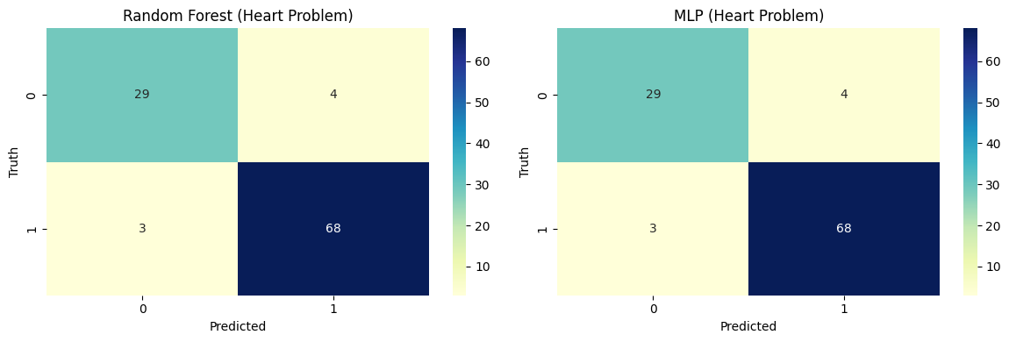
Heart Problem Confusion Matrix

Slide 21
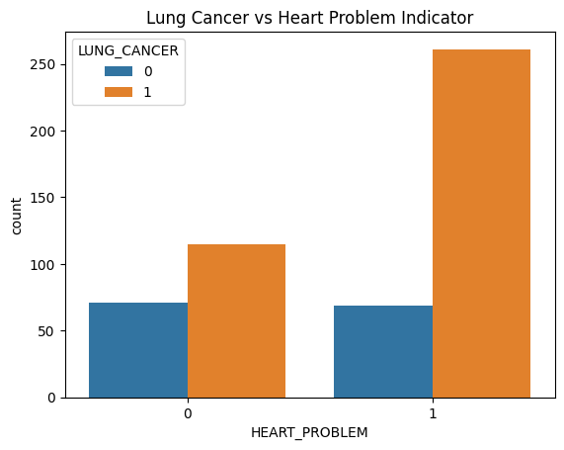
Lung Cancer vs Heart Problem

Slide 22
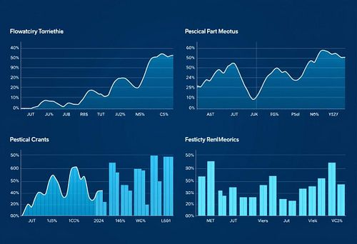
Results
1. Lung Cancer (MLP Extended)
achieved top performance with F1 score at 0.94 and
accuracy 0.89.
2. Mental Health (Random Forest)
showed solid results, F1 score of 0.81 and accuracy 0.78.
3. Jaundice (Random Forest)
scored F1 score of 0.85 and accuracy 0.82, indicating
reliable predictions.
4. Heart Problem (RF/MLP)
delivered best outcomes, F1 score at 0.95 and accuracy 0.93.

Slide 23
Model Performance Table
Model | F1-Score | Accuracy
Random Forest Classifier | 0.88 | 0.80
Multi-Layer Perceptron | 0.90 | 0.83
MLP (New Features) | 0.91 | 0.84
MLP (Features Extend) | 0.94 | 0.89
Random Forest (Mental Health) | 0.81 | 0.78
LSTM (Mental Health) | 0.66 | 0.64
Random Forest (Jaundice) | 0.85 | 0.82
MLP (Jaundice) | 0.78 | 0.69
Random Forest (Heart Problem) | 0.95 | 0.93
MLP (Heart Problem) | 0.95 | 0.93

Slide 24
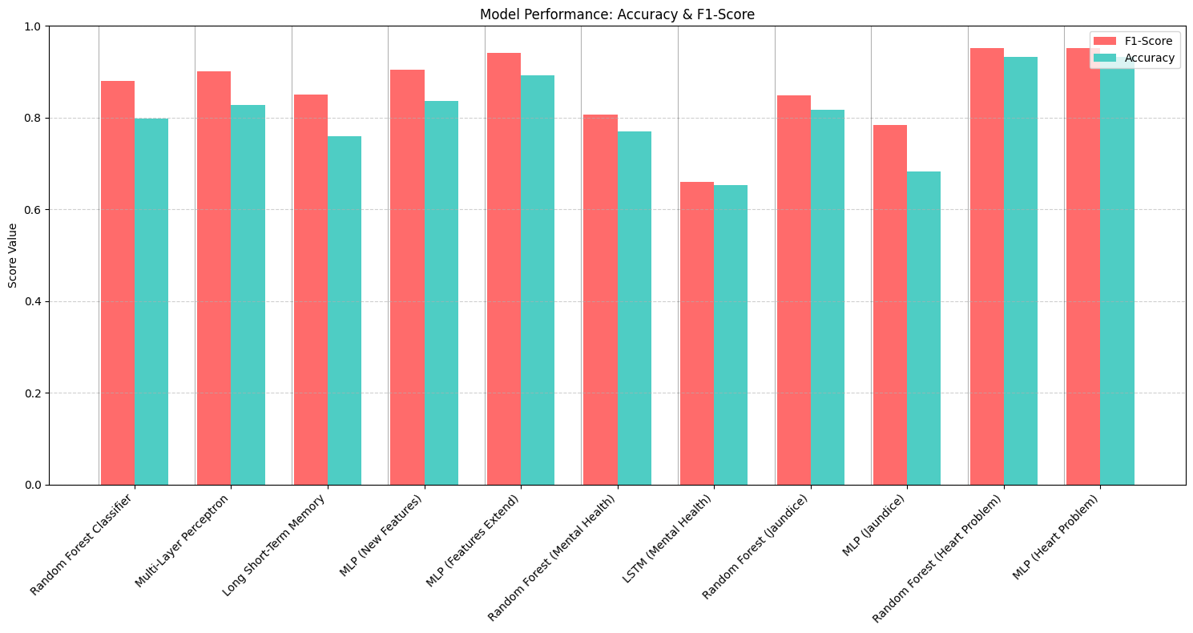
Model Performance Bar Graph

Slide 25
Conclusion
The study shows how feature engineering and synthetic targets improve model accuracy.
Careful model selection boosts prediction reliability in healthcare diagnostics.
These insights aid real-time health screening, especially in resource-limited environments.
1. Feature Engineering
Crafting relevant features enhances the learning process and outcome quality.
2. Synthetic Target Generation
Creating artificial targets adds robustness for rare condition predictions.
3. Model Selection
Choosing the right algorithm ensures optimal balance of accuracy and speed.

Slide 26

Future Scope
Heart Disease Prediction Enhancement Integrate hereditary data to boost personalization and accuracy.
Lung Cancer Model Expansion Use medical imaging to predict damage extent and location.
Multi-Disease Diagnostic Models Predict multiple ailments simultaneously with diverse data integration.

Slide 27
References
[1] S. K. Sharma and S. Goyal, “Early Detection of Lung Cancer Using Machine Learning Algorithms,” Procedia Computer Science, vol. 167, pp. 1810–1819, 2020.
[2] S. Minaee et al., “Image-based COVID-19 Diagnosis: A Comprehensive Review,” IEEE Access, vol. 8, pp. 195521–195545, 2020.
[3] A. Esteva et al., “Dermatologist-level Classification of Skin Cancer with Deep Neural Networks,” Nature, vol. 542, no. 7639, pp. 115–118, 2017.
[4] A. Rahman and S. Muniyandi, “Lung Cancer Prediction Using Data Mining Techniques,” International Journal of Science and Research, vol. 3, no. 6, pp. 2319–7064, 2014.
[5] S. Choudhury and P. Gupta, “A Review on Lung Cancer Detection Using Machine Learning Techniques,” Materials Today: Proceedings, vol. 62, pp. 7692–7700, 2022.
[6] K. M. Hosseini et al., “Feature Selection for Medical Diagnosis: Evaluation for Lung Cancer,” in Proc. IEEE Int. Conf. on Bioinformatics and Biomedicine (BIBM), 2018, pp. 1099–1102.
[7] S. Hochreiter and J. Schmidhuber, “Long Short-Term Memory,” Neural Computation, vol. 9, no. 8, pp. 1735–1780, 1997.
[8] J. Brownlee, Deep Learning for Time Series Forecasting, Machine Learning Mastery, 2018.
[9] N. Srivastava et al., “Dropout: A Simple Way to Prevent Neural Networks from Overfitting,” Journal of Machine Learning Research, vol. 15, pp. 1929–1958, 2014.
[10] M. Mohan, C. Thirumalai, and G. Srivastava, “Effective Heart Disease Prediction Using Hybrid Machine Learning Techniques,” IEEE Access, vol. 7, pp. 81542–81554, 2019.

Slide 28
Thank You

